Slide 1
Time Value of Money
Concept of time value of money;
Cash flow time line;
Future values and present values of a single cash flow;
Finding the interest rate and the number of years;
Future value and present value of an ordinary annuity and annuity due;
Finding annuity payments, periods and interest rates;
Present value of perpetuities;
Present value and future value of uneven cash flows;
Semiannual and other compounding periods;
Preparation of loan amortization schedule;
Application of the concept of time value of money.

Slide 2
Concept of Time Value of Money
The value of money received one year from now is not the same as the value of money received today.
Time value of money can be defined as the relationship between time and value of money.
Why money has time value ?
Reinvestment opportunity
Inflation
Sacrifice of present consumption
Application/ Significance of time value of money:
Investment Decision
Financing Decision

Slide 3
Cash flow time line
A graphical representation which is used to show the timing of cash flow.
Used to show cash payments as well as receipts; cash payments are negative whereas cash received are positive
0 10% 1 2 3 4 5 6 n
-100 10 10 10 10 10 10 100+10
Time 0 represent today or just now or at the beginning of period 1
Time 1 states that the period 1 has just been ended and period 2 has just begun and so on
Time period denoted on scale has generally a length of 1 year however it could be 6 months or three months or monthly depending for the period of compounding or discounting.
Interest rate is placed in between two corresponding time periods.
Interest rate may differ from period to period; in such case interest rate must be stated between every time period

Slide 4
Future value of a Single Amount
Future value is the sum of money to which a present sum grows over future period of time at a given rate of interest
Future value for single period investment:
Rs 100 invested for 1 year period at 10% annual interest rate
Value after one year (FV) = Initial investment (1+i) i.e. PV (1+i)
= Rs 100 (1+0.1) = Rs 110
Future value for multiple period investment:
Rs 100 invested for 2 years period at 10% annual interest rate
Value after two year (FV) = Initial investment (1+i) (1+i) i.e. PV (1+i)^{n}
= Rs 100 (1+0.1)² = Rs 121
Thus we have, FV_{n} = PV (1+i)^{n}
where, FV_{n}= future value of a sum of money at the end of period n
PV = present value or sum of money today
I = annual interest rate at which money is invested
n = number of years for which the sum of money is compounded

Slide 5
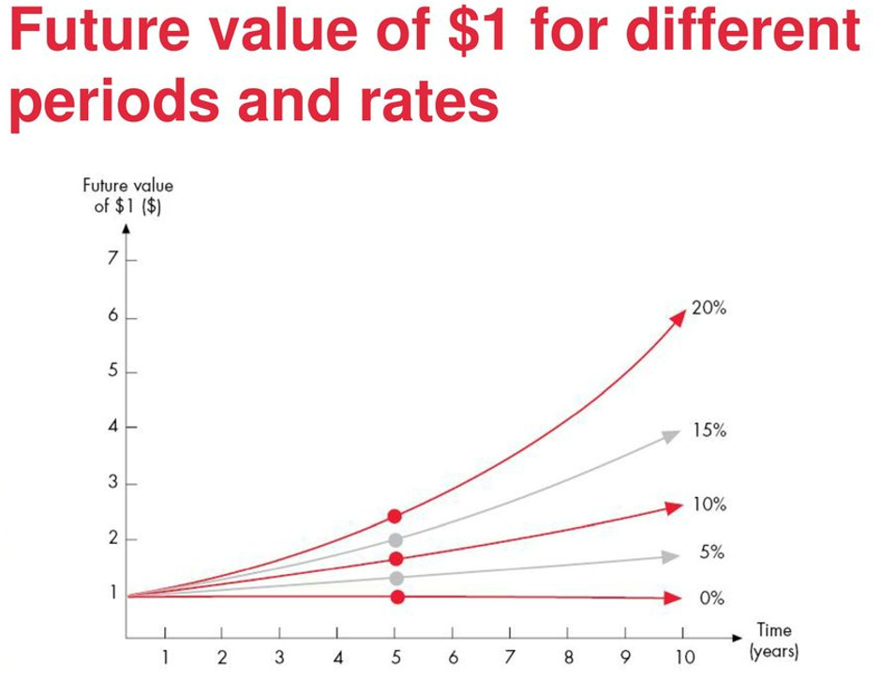
Cont…
Simple interest = interest earned only on original investment
Compound Interest = Interest earned on interest
Calculating Future value using FVIF table
FV_{n} = PV ( FVIF _{i,n})
Previous example: FV_{n} = PV ( FVIF _{10%,2}) = Rs 100 * 1.21 = Rs 121

Slide 6
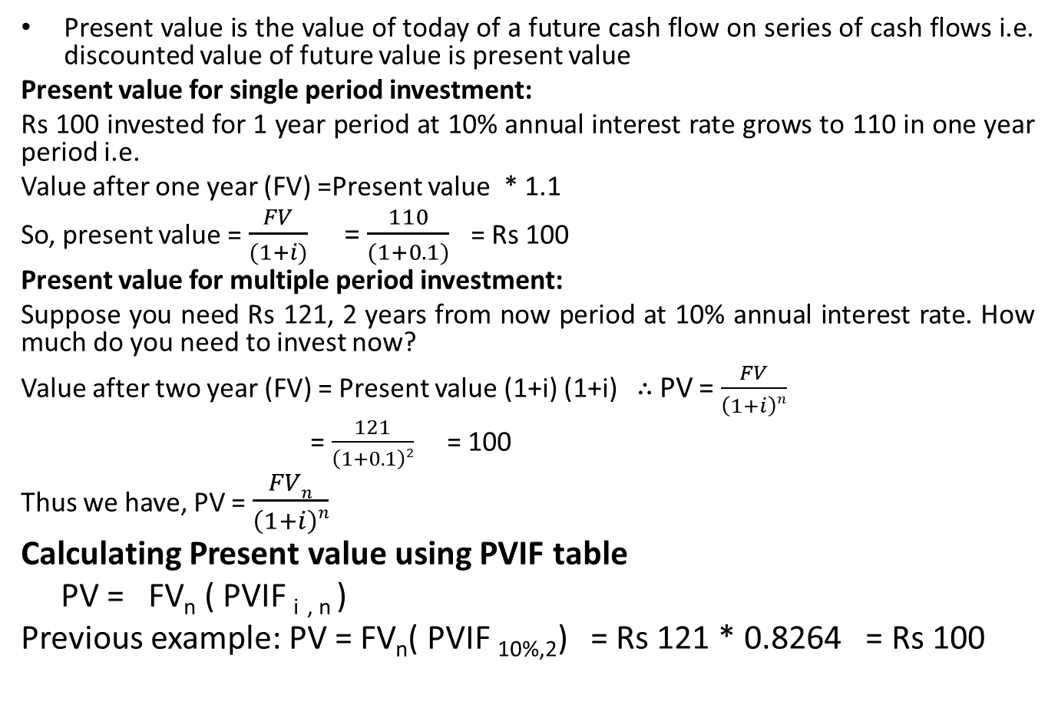
Present value of a Single Amount
Present value is the value of today of a future cash flow on series of cash flows i.e. discounted value of future value is present value
Present value for single period investment:
Rs 100 invested for 1 year period at 10% annual interest rate grows to 110 in one year period i.e.
Value after one year (FV) =Present value * 1.1
So, present value = $\frac{FV}{(1+i)}$ = $\frac{110}{(1+0.1)}$ = Rs 100
Present value for multiple period investment:
Suppose you need Rs 121, 2 years from now period at 10% annual interest rate. How much do you need to invest now?
Value after two year (FV) = Present value (1+i) (1+i) ∴ PV = $\frac{FV}{\left(1+i\right)n}$
= $\frac{121}{\left(1+0.1\right)2}$ = 100
Thus we have, PV = $\frac{FVn}{\left(1+i\right)n}$
Calculating Present value using PVIF table
PV = FV_{n} ( PVIF _{i} _{, n} )
Previous example: PV = FV_{n}( PVIF _{10%,2}) = Rs 121 * 0.8264 = Rs 100

Slide 7
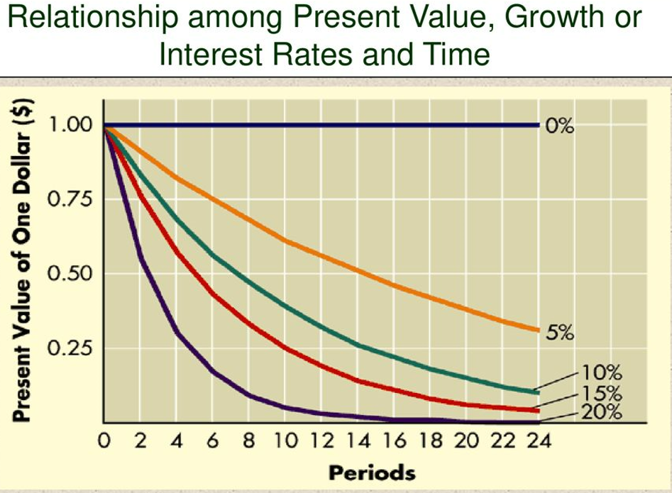
Relationship between present value and interest rates over different time period

Slide 8
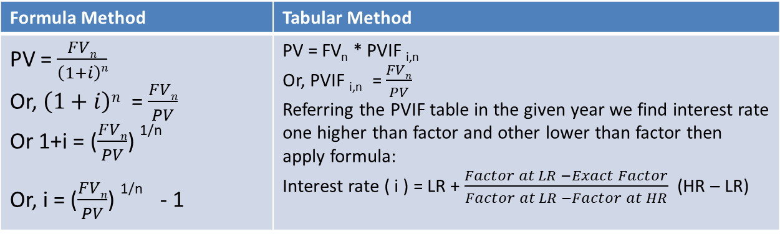
Finding the Interest Rate
Single Period Case
Multi Period Case
Formula Method | Tabular Method
FV₁ = PV (1+i) | FV₁ = PV * FVIF _{i,1}
Or, 110 = 100 (1+i) | 110 = 100 * FVIF _{i,1}
Or, 1.1 = 1+i | 1.10 = FVIF _{i,1}
Or, i= 0.1 or, 10 % | Referring FVIF table in 1 year, the factor value of 1.10 lies at year 10%. Thus interest rate is 10%
Formula Method | Tabular Method
PV = $\frac{FVn}{\left(1+i\right)n}$ Or, $\left(1+i\right)n$ = $\frac{FVn}{PV}$ Or 1+i = ($\frac{FVn}{PV}$) ^{1/n} Or, i = ($\frac{FVn}{PV}$) ^{1/n} - 1 | PV = FV_{n} * PVIF _{i,n} Or, PVIF _{i,n} = $\frac{FVn}{PV}$ Referring the PVIF table in the given year we find interest rate one higher than factor and other lower than factor then apply formula: Interest rate ( i ) = LR + $\frac{Factor at LR −Exact Factor}{Factor at LR −Factor at HR}$ (HR – LR)

Slide 9
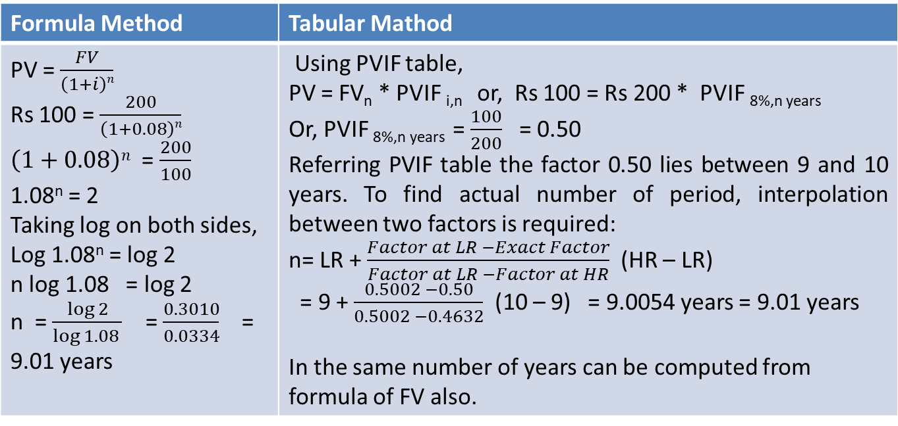
Finding the Number of years
PV = Rs 100, FV = 200, i= 8%, n =?
Formula Method | Tabular Mathod
PV = $\frac{FV}{\left(1+i\right)n}$ Rs 100 = $\frac{200}{\left(1+0.08\right)n}$ $\left(1+0.08\right)n$ = $\frac{200}{100}$ 1.08^{n} = 2 Taking log on both sides, Log 1.08^{n} = log 2 n log 1.08 = log 2 n = $\frac{\log{2}}{\log{1.08 }}$ = $\frac{0.3010}{0.0334}$ = 9.01 years | Using PVIF table, PV = FV_{n} * PVIF _{i,n} or, Rs 100 = Rs 200 * PVIF _{8%,n years} Or, PVIF _{8%,n years} = $\frac{100}{200}$ = 0.50 Referring PVIF table the factor 0.50 lies between 9 and 10 years. To find actual number of period, interpolation between two factors is required: n= LR + $\frac{Factor at LR −Exact Factor}{Factor at LR −Factor at HR}$ (HR – LR) = 9 + $\frac{0.5002 −0.50}{0.5002 −0.4632}$ (10 – 9) = 9.0054 years = 9.01 years In the same number of years can be computed from formula of FV also.

Slide 10
Annuity
Annuity: A series of payments of equal amount at fixed intervals for a specified number of years
Ordinal Annuity : An annuity whose payments occur at the end of each period
0 1 2 3 4
500 500 500 500
Annuity Due: An annuity whose payments occur at the beginning of each period
0 1 2 3 4
500 500 500 500
The difference between annuity and annuity due is each cash flow occur one period earlier in the annuity due than ordinary annuity.

Slide 11
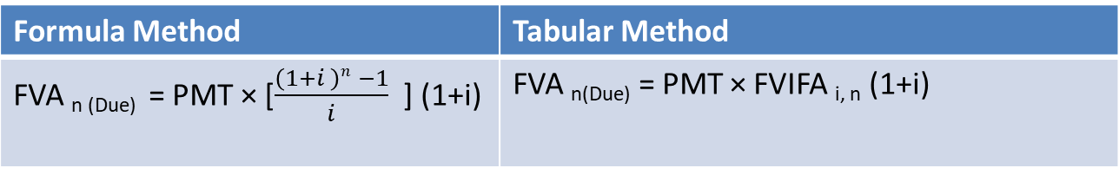
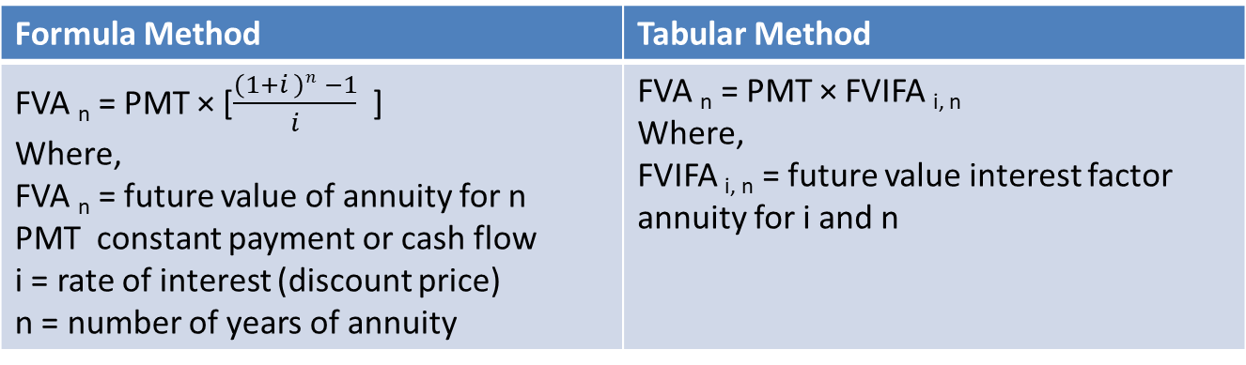
Future value of an ordinary annuity and annuity due
Future value of ordinary annuity:
Future value of annuity due:
Formula Method | Tabular Method
FVA _{n} = PMT × [$\frac{\left(1+i \right)n −1}{i}$ ] Where, FVA _{n} = future value of annuity for n PMT constant payment or cash flow i = rate of interest (discount price) n = number of years of annuity | FVA _{n} = PMT × FVIFA _{i, n} Where, FVIFA _{i, n} = future value interest factor annuity for i and n
Formula Method | Tabular Method
FVA _{n (Due)} = PMT × [$\frac{\left(1+i \right)n −1}{i}$ ] (1+i) | FVA _{n(Due)} = PMT × FVIFA _{i, n} (1+i)

Slide 12
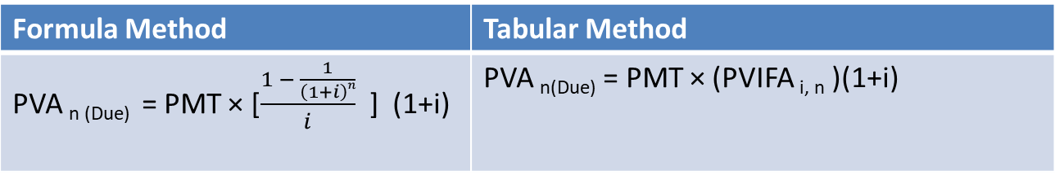
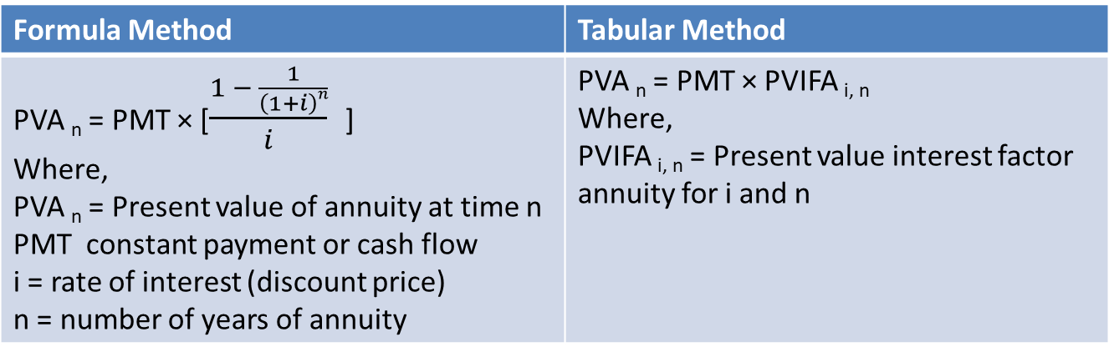
Present value of an ordinary annuity and annuity due
Present value of ordinary annuity:
Present value of annuity due:
Formula Method | Tabular Method
PVA _{n} = PMT × [$\frac{1 − \frac{1}{\left(1+i\right)n}}{i}$ ] Where, PVA _{n} = Present value of annuity at time n PMT constant payment or cash flow i = rate of interest (discount price) n = number of years of annuity | PVA _{n} = PMT × PVIFA _{i, n} Where, PVIFA _{i, n} = Present value interest factor annuity for i and n
Formula Method | Tabular Method
PVA _{n (Due)} = PMT × [$\frac{1 − \frac{1}{\left(1+i\right)n}}{i}$ ] (1+i) | PVA _{n(Due)} = PMT × (PVIFA _{i, n} )(1+i)

Slide 13
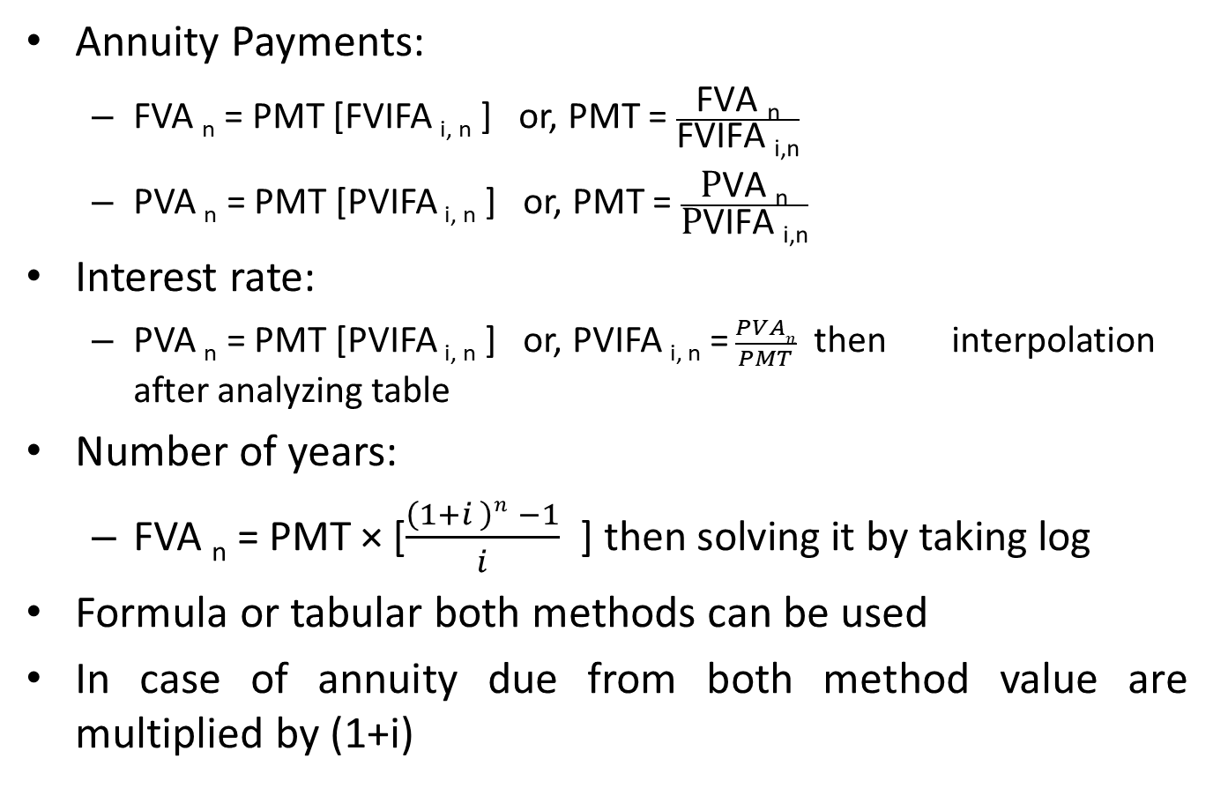
Finding annuity payments, interest rate and number of years in ordinary annuity
Annuity Payments:
FVA _{n} = PMT [FVIFA _{i, n} ] or, PMT = $\frac{\text{FVA} \text{n}}{\text{FVIFA} \text{i}\text{,}\text{n}}$
PVA _{n} = PMT [PVIFA _{i, n} ] or, PMT = $\frac{\text{P}\text{VA} \text{n}}{\text{P}\text{VIFA} \text{i}\text{,}\text{n}}$
Interest rate:
PVA _{n} = PMT [PVIFA _{i, n} ] or, PVIFA _{i, n} =$\frac{PVAn}{PMT}$then interpolation after analyzing table
Number of years:
FVA _{n} = PMT × [$\frac{\left(1+i \right)n −1}{i}$ ] then solving it by taking log
Formula or tabular both methods can be used
In case of annuity due from both method value are multiplied by (1+i)

Slide 14
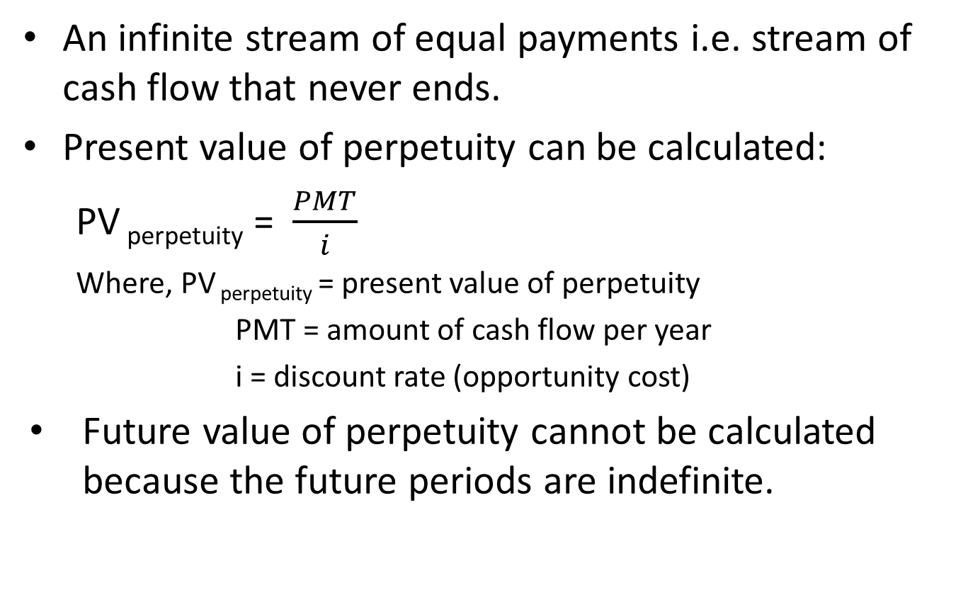
Perpetuity
An infinite stream of equal payments i.e. stream of cash flow that never ends.
Present value of perpetuity can be calculated:
PV _{perpetuity} = $\frac{PMT}{i}$
Where, PV _{perpetuity} = present value of perpetuity
PMT = amount of cash flow per year
i = discount rate (opportunity cost)
Future value of perpetuity cannot be calculated because the future periods are indefinite.

Slide 15

Present value and Future value of uneven cash flow
Present Value:
Formula Method:
PV = $\frac{CF1}{\left(1+i\right)1}$ + $\frac{CF2}{\left(1+i\right)2}$ + $\frac{CF3}{\left(1+i\right)3}$ + $\frac{CF4}{\left(1+i\right)4}$ + ……. + $\frac{CFn}{\left(1+i\right)n}$
Tabular method:
Future Value:
Formula Method:
FV_{n} = CF₁(1+i)^{n-1} + CF₂ (1+i)^{n-2} + ……+ CF₃ (1+i)^{n-3}
Tabular Method:
Year | Cash flow | PVIF _{i, n} | PV = cash flow * PVIF _{i, n}
Year | Cash flow | FVIF _{i, n} | FV = cash flow * FVIF _{i,n}

Slide 16
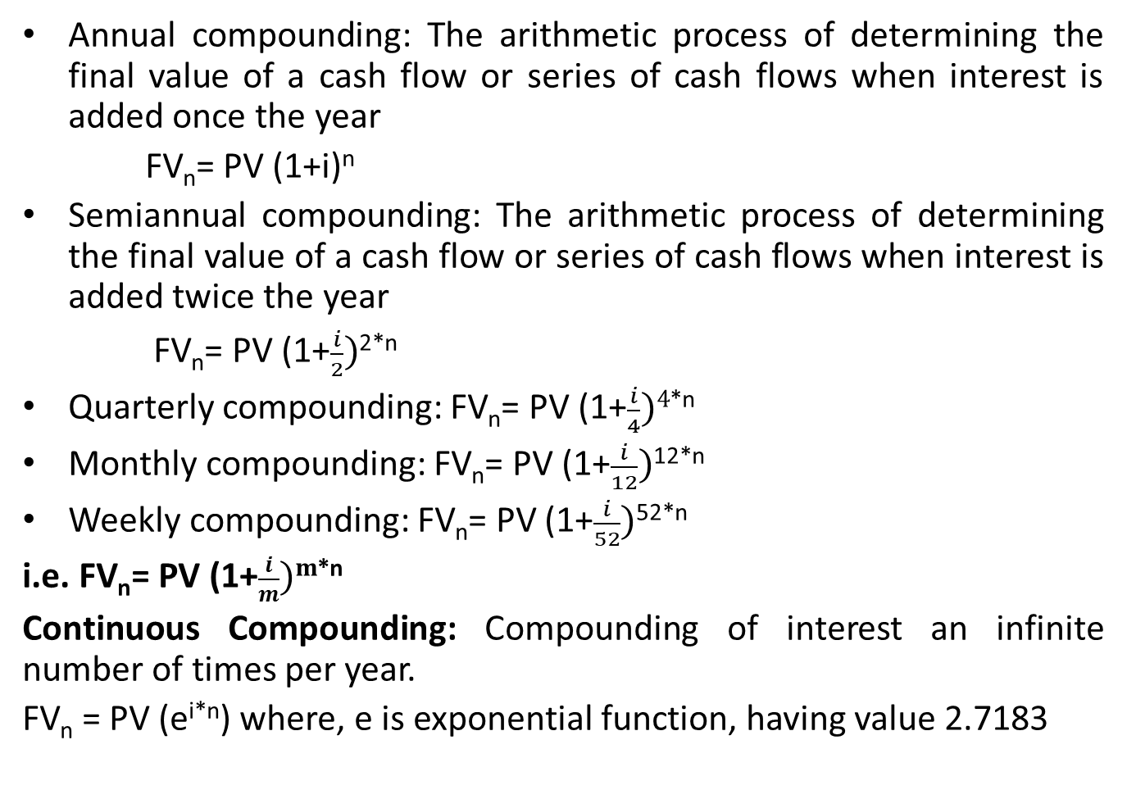
Semiannual and other compounding period
Annual compounding: The arithmetic process of determining the final value of a cash flow or series of cash flows when interest is added once the year
FV_{n}= PV (1+i)^{n}
Semiannual compounding: The arithmetic process of determining the final value of a cash flow or series of cash flows when interest is added twice the year
FV_{n}= PV (1+$\frac{i}{2})$^{2*n}
Quarterly compounding: FV_{n}= PV (1+$\frac{i}{4})4$^{*n}
Monthly compounding: FV_{n}= PV (1+$\frac{i}{12})$^{12*n}
Weekly compounding: FV_{n}= PV (1+$\frac{i}{52})$^{52*n}
i.e. FV_{n}= PV (1+$\frac{i}{m})m$^{*n}
Continuous Compounding: Compounding of interest an infinite number of times per year.
FV_{n} = PV (e^{i*n}) where, e is exponential function, having value 2.7183

Slide 17
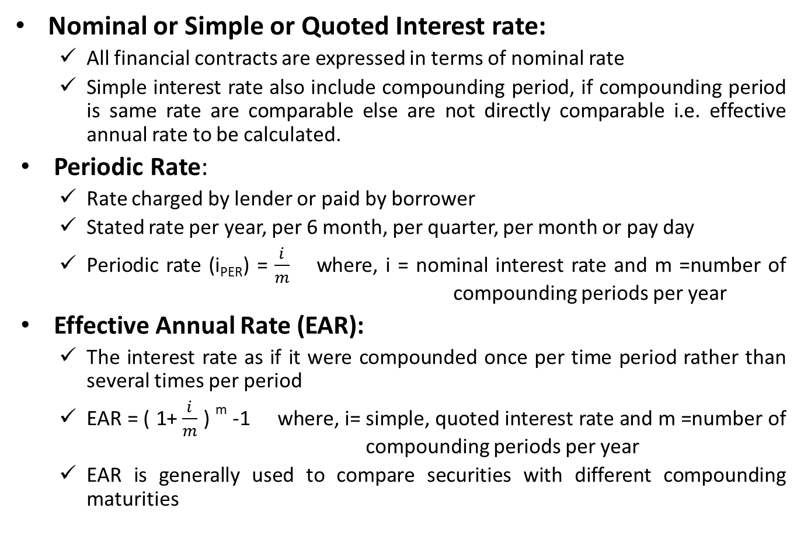
Comparison of different types of interest rate
Nominal or Simple or Quoted Interest rate:
All financial contracts are expressed in terms of nominal rate
Simple interest rate also include compounding period, if compounding period is same rate are comparable else are not directly comparable i.e. effective annual rate to be calculated.
Periodic Rate:
Rate charged by lender or paid by borrower
Stated rate per year, per 6 month, per quarter, per month or pay day
Periodic rate (i_{PER}) = $\frac{i}{m}$ where, i = nominal interest rate and m =number of compounding periods per year
Effective Annual Rate (EAR):
The interest rate as if it were compounded once per time period rather than several times per period
EAR = ( 1+ $\frac{i}{m}$ ) ^{m} -1 where, i= simple, quoted interest rate and m =number of compounding periods per year
EAR is generally used to compare securities with different compounding maturities

Slide 18
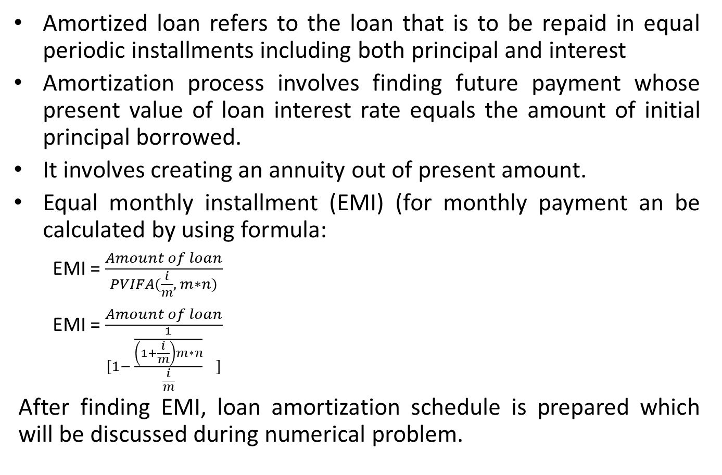
Loan Amortization Schedule
Amortized loan refers to the loan that is to be repaid in equal periodic installments including both principal and interest
Amortization process involves finding future payment whose present value of loan interest rate equals the amount of initial principal borrowed.
It involves creating an annuity out of present amount.
Equal monthly installment (EMI) (for monthly payment an be calculated by using formula:
EMI = $\frac{Amount of loan}{PVIFA(\frac{i}{m}, m∗n)}$
EMI = $\frac{Amount of loan}{[1− \frac{\frac{1}{\left(1+\frac{i}{m}\right)m∗n}}{\frac{i}{m}} ]}$
After finding EMI, loan amortization schedule is prepared which will be discussed during numerical problem.

Slide 19
Application of the time value of money
Valuation of securities and other assets
Capital budgeting (the analysis of investment projects)
Lease analysis
The cost of capital
Working capital (short-term asset and liabilities) management
Tradeoff between risk and return

